Slide 1
Rstudio basics: common issues with RMD

Slide 2
Outline
RStudio
What is Rstudio?
R vs RMD
RMD file vs Console
Common Issues / FAQs
Installing vs Loading Packages
Set Working Directory
Paths: Absolute vs Relative
Pipe Operator: Update tidyverse
Macs
XQuartz
Trouble Shooting
Read Error Messages
Inspect Console
Knitting RMD Files
Steps
Common Issues
I/O
View()
Xquartz (Mac)
Github
What is Github
How do I get files
Pull Requests

Slide 3
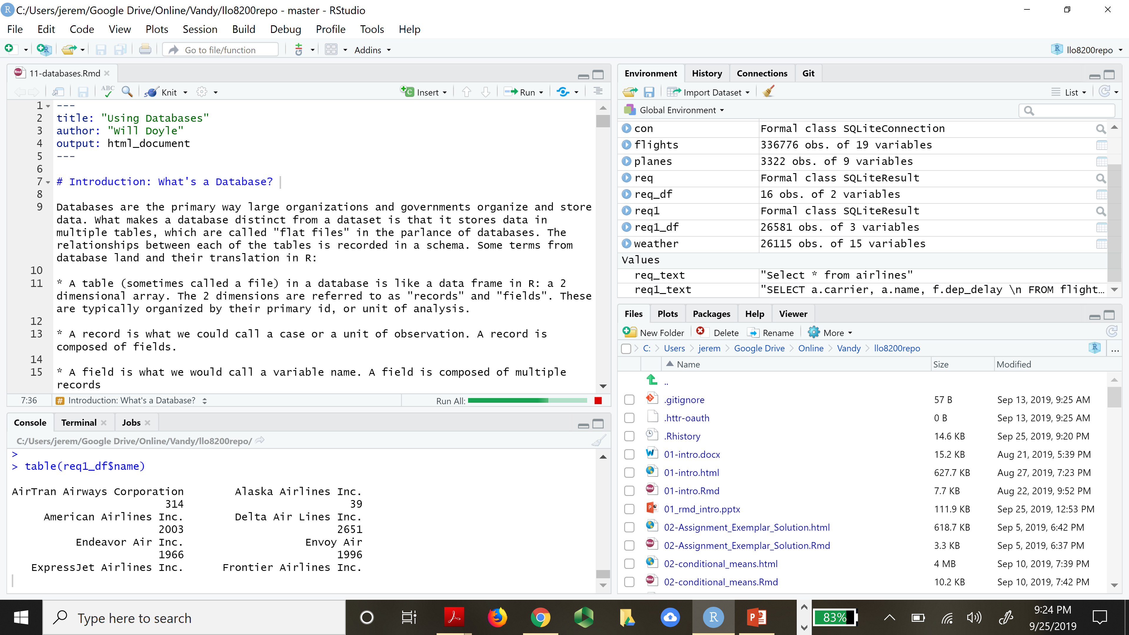
Rstudio Interface
Interpreter
Executes R code
Interface
Split into quadrants
Viewer
Environment
Console
Files / Directory

Slide 4
Viewer vs console
Viewer vs Console
Files vs console
Command prompt

Slide 5
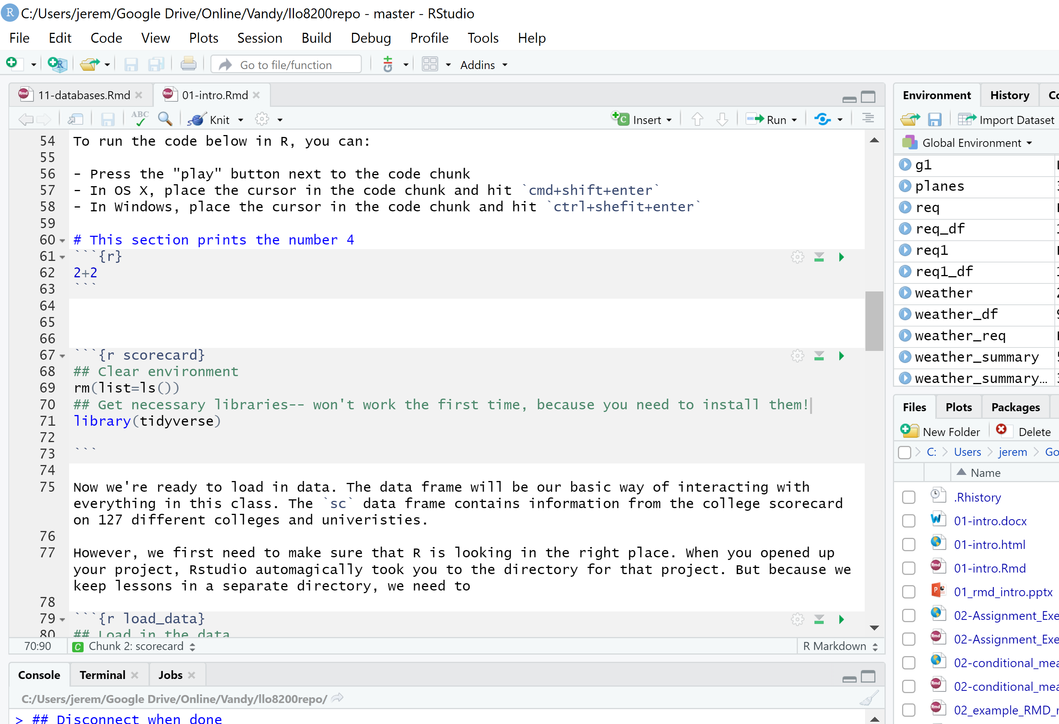
R vs rmd
RMD
R-chunks
Plain Text
Formatting
See knit tutorial
Execution
Run
Run by chunk

Slide 6
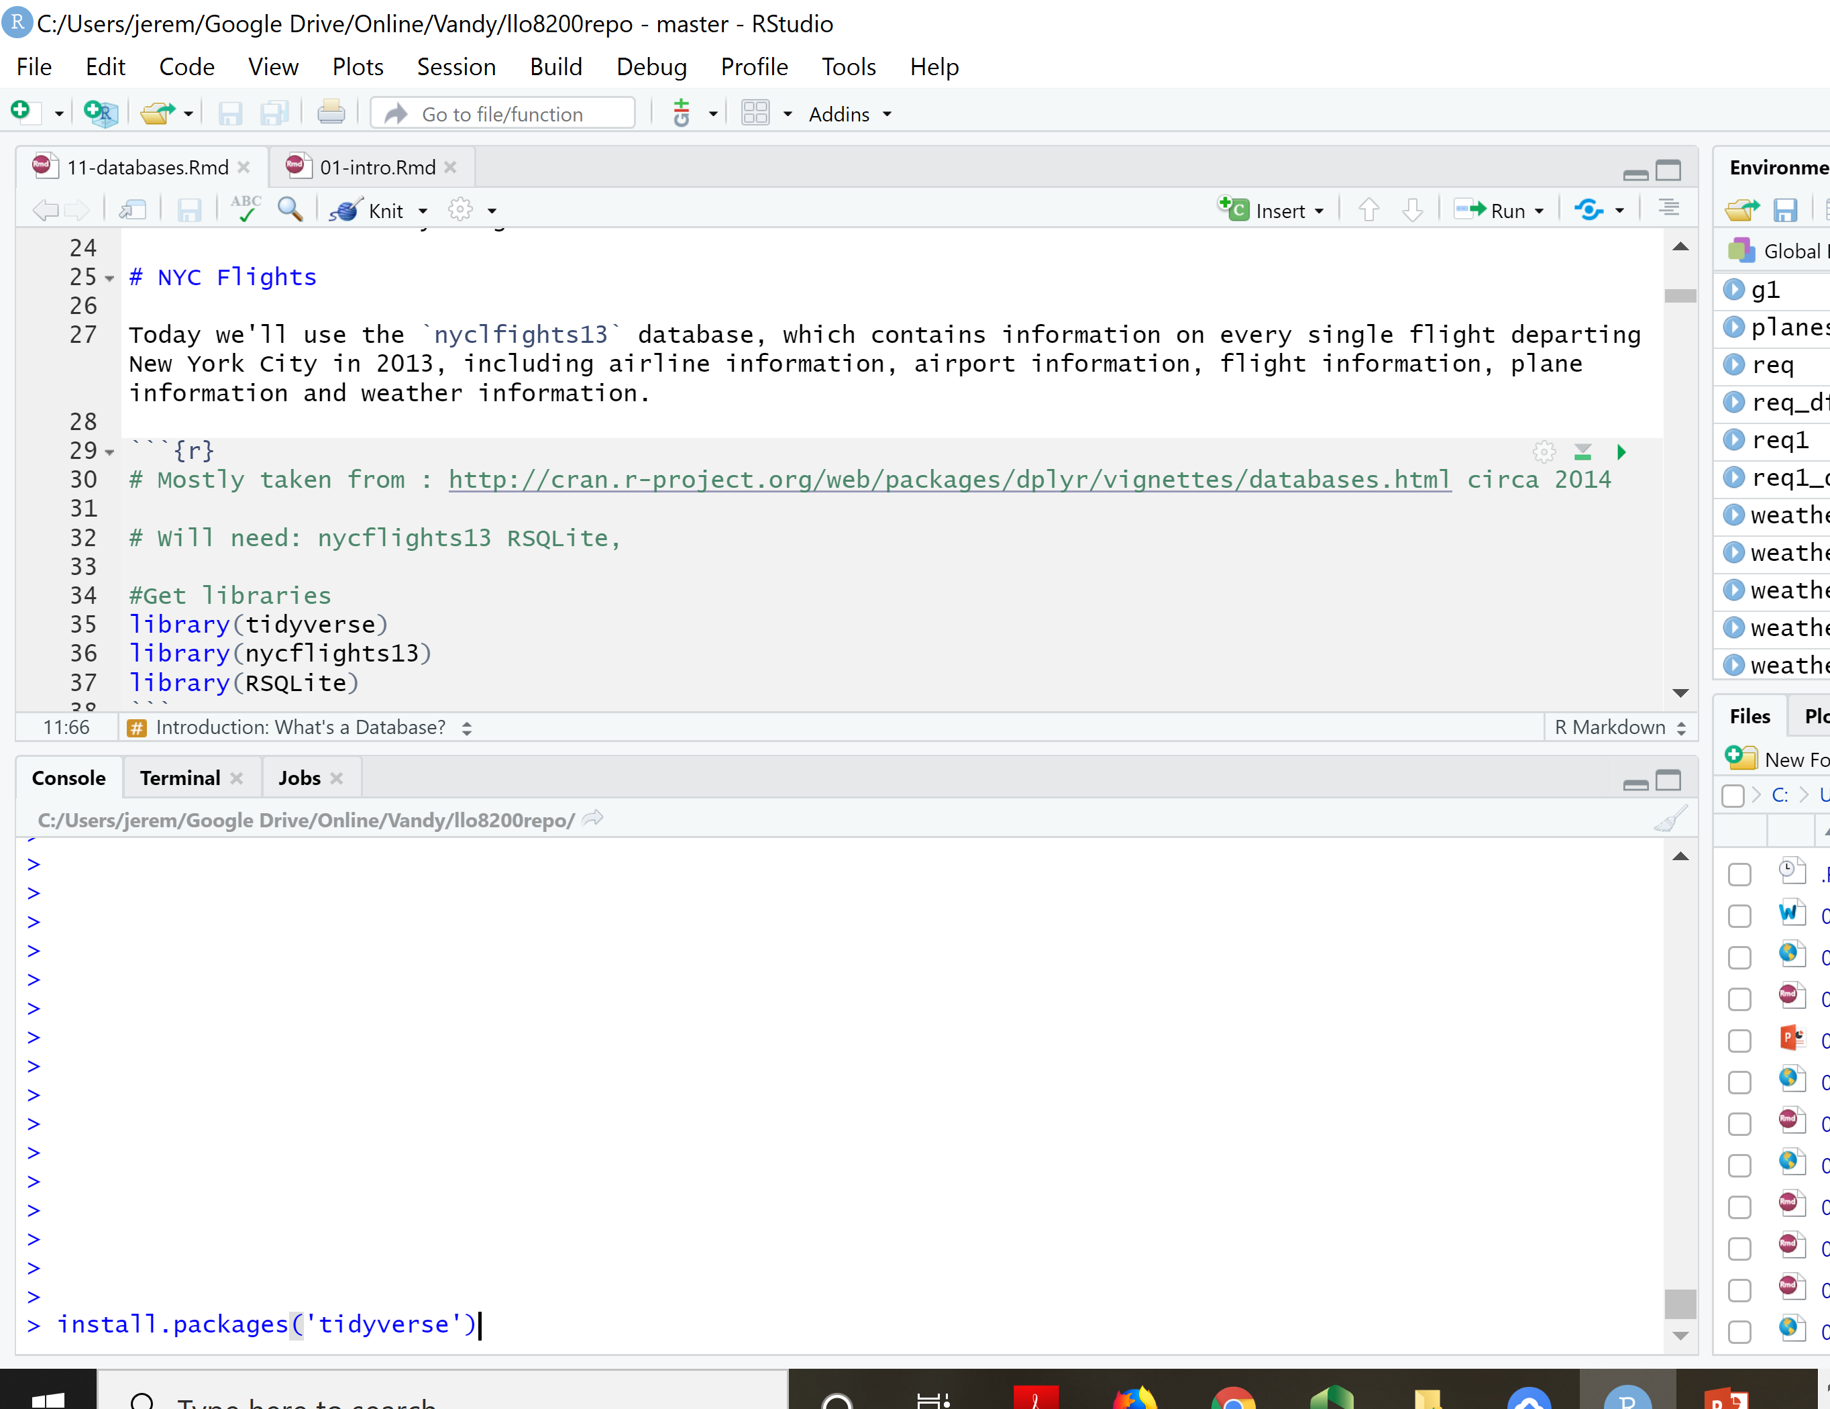
Installing vs loading packages
Packages
We will use many packages throughout the term
Each package will need to be installed once
Each package to be used must be loaded prior to each use
Example
Install tidyverse
Load tidyverse

Slide 7
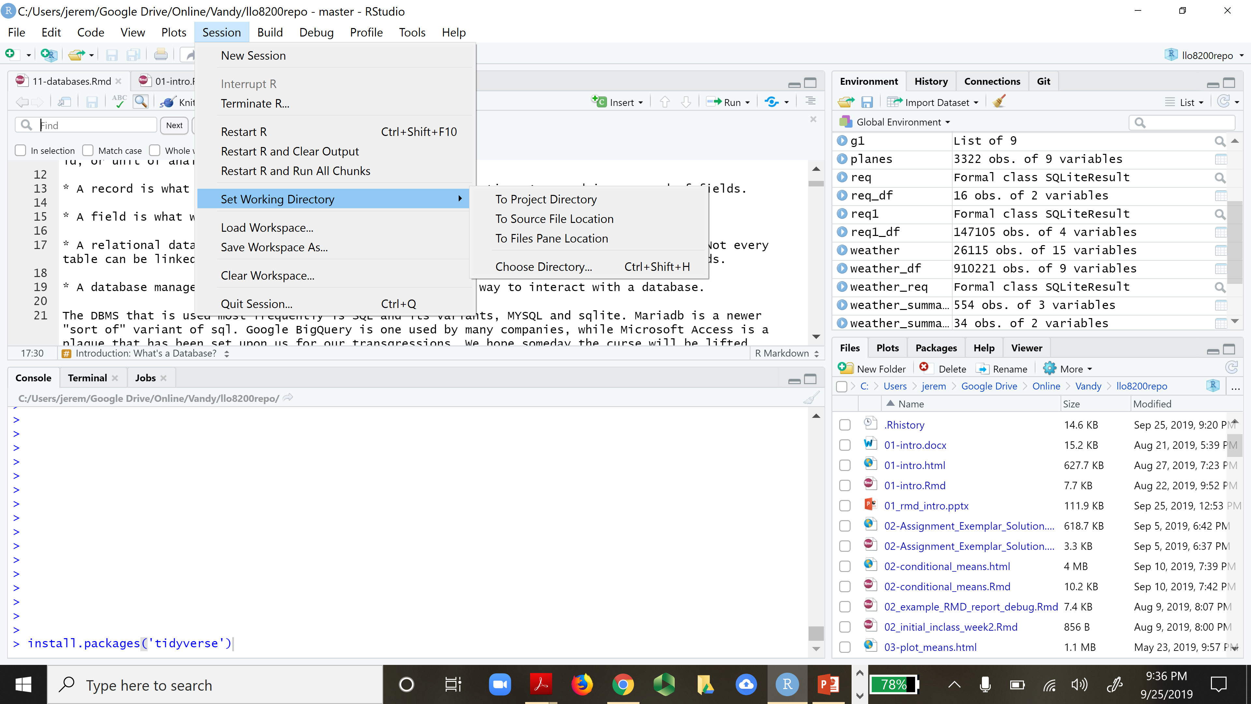
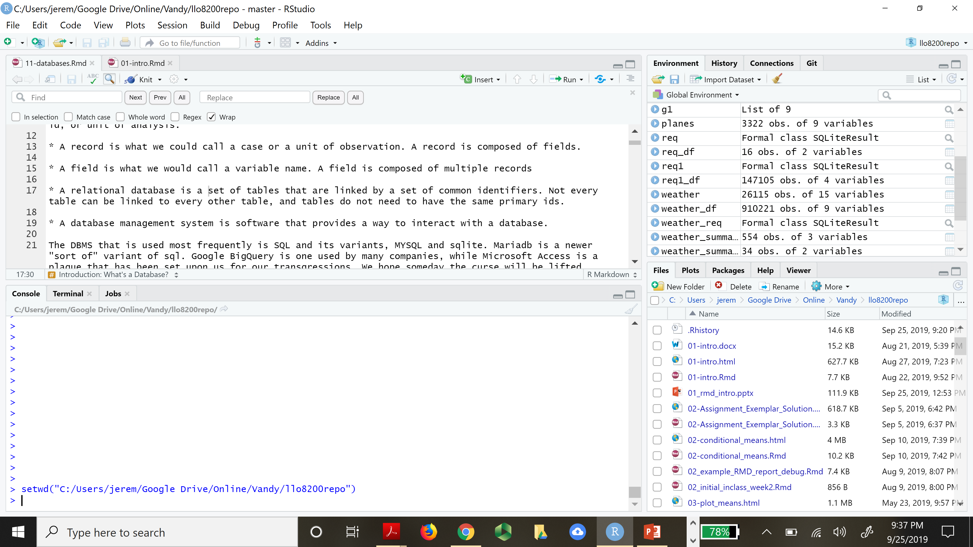
Working directory
The working directory is the folder where you executing program has access
To read files
Load data
Write files
etc

Slide 8
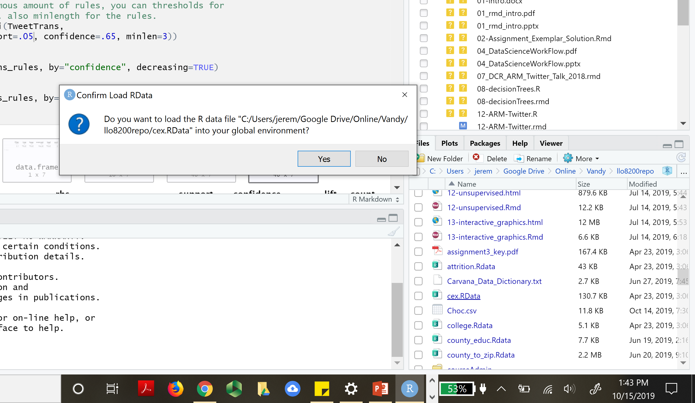
Absolute vs relative paths
Absolute path is a sequence of names of of folders starting at the root directory and ending at a file name
Relative path may only include the file name.
load("C:/Users/jerem/Google Drive/Online/Vandy/llo8200repo/cex.Rdata")
Click here
load(“cex.Rdata")
Find absolute path here

Slide 9
Pipe operator
On Mac OS X if you use RStudio or R from the terminal, you must have a copy of XQuartz, the X11 window manager, installed. This is no longer a default install since Mac OS X 10.8. You need to install XQuartz. Logout and login for the installation to take effect.
You can get it from https://xquartz.macosforge.org/landing/.
This page is also linked from the Download R for (Mac) OS X page.
Pipe Operator: %>%
Common issues / fixes
update tidyverse
mac users: install xquartz

Slide 10
Trouble shooting
Troubleshooting and debugging is part of the programming experience. I cannot help you overcome all obstacles; instead you will learn to be self-sufficient.
Read the error messages – they can be very useful
What lines are mentioned?
What key words are mentioned?
Check the console
Error messages are here
Assess the state of execution

Slide 11
Knitting RMD files
Knitting RMD Files
FIRST: Read the tutorial I posted … it contains all info you will need.
Common Issues
I/O
Remove I/O if possible, otherwise you may not be able to knit … which is OK
View()
Fix: Simply remove or comment out this code as it is for viewing only
Xquartz (Mac)
Install and run xquartz
See tutorial posted.
R-Chunk Labels must be unique!!

Slide 12
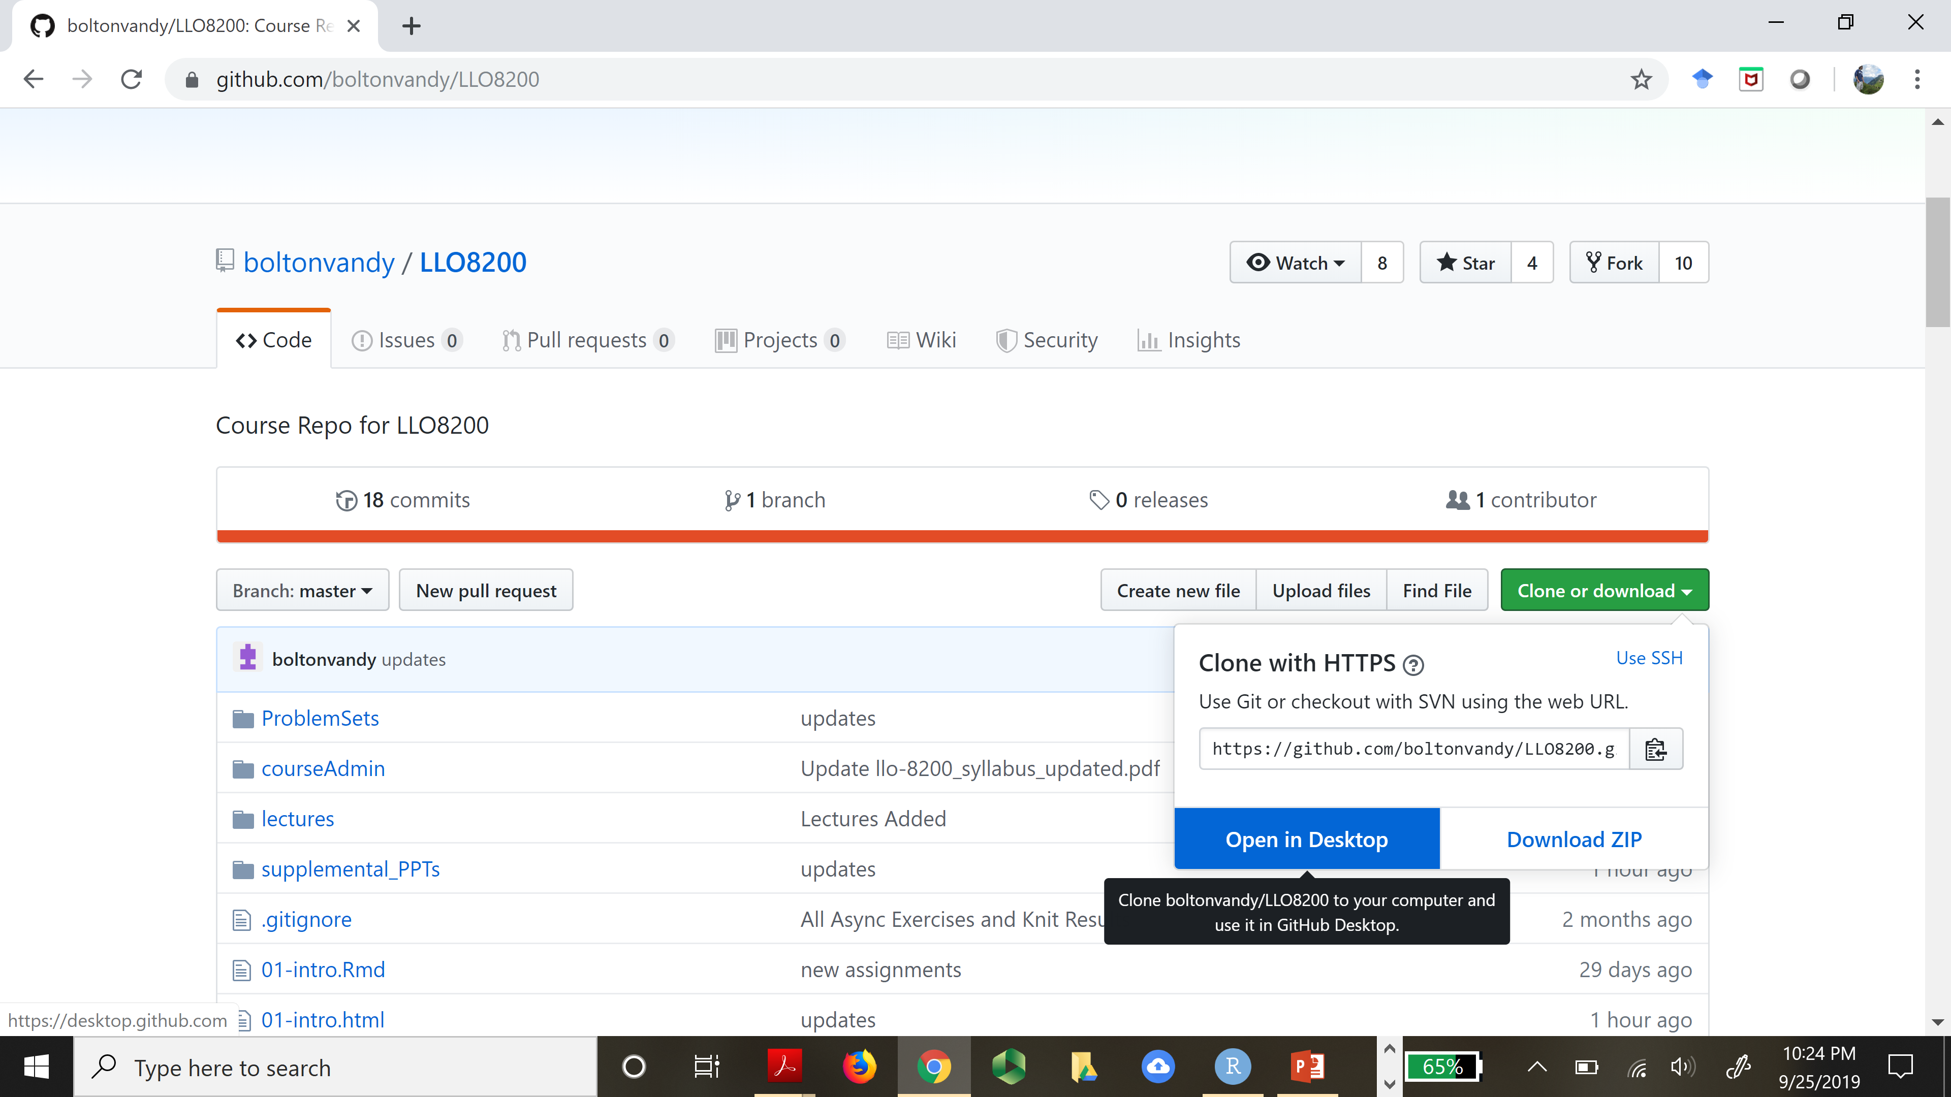
Github
Github
A repository for documents which supports
Version control
Cloud storage / access
Collaboration
Course
ALL course documents are on course Git Repository. Do not use files on LMS.
Get course documents by cloning the course repo
You may also “link” Rstudio with Git but this is not necessary.

Slide 13
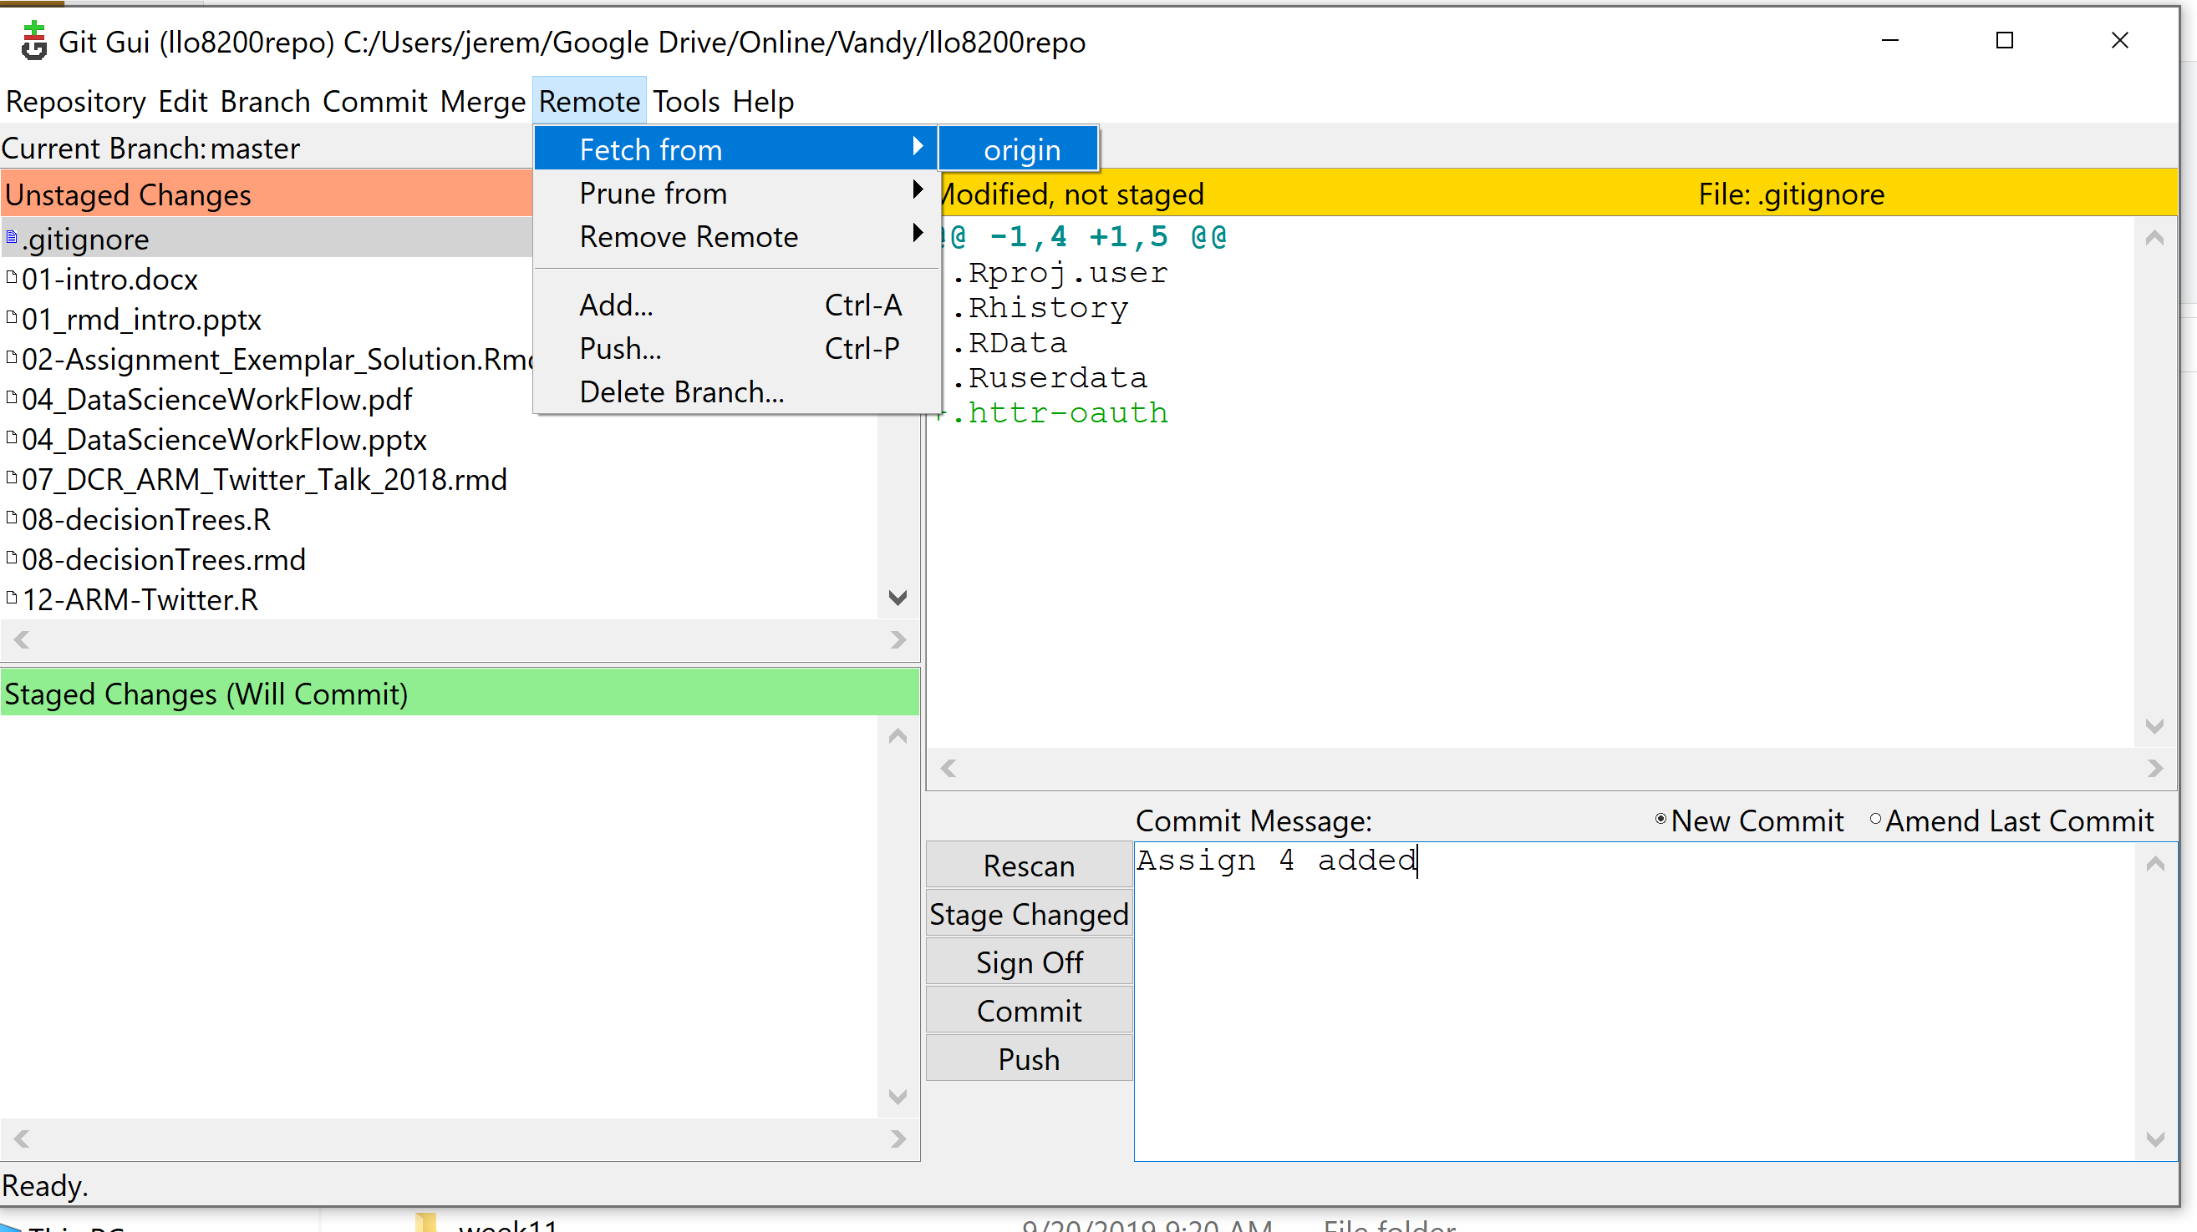
Clone and pull (Fetch) requests
Git nomenclature
Clone: download a copy of the repository
Previous slide
Pull: update your copy of the repository to include any recent updates
Github Desktop or Git GUI
Interface to manage repositories
Download Github desktop to help with pull requests

